Slide 1
NYPD Shootings 2006-2022
Apeksha ingole, Samuel klein, madeline riley

Slide 2
Project overview
Data from the NYPD of shootings from 2006-2022
Broken down into three categories; shootings, locations, demographics
This data can help police identify where shootings might occur and who is most likely to be a victim

Slide 3
shootings

Slide 4
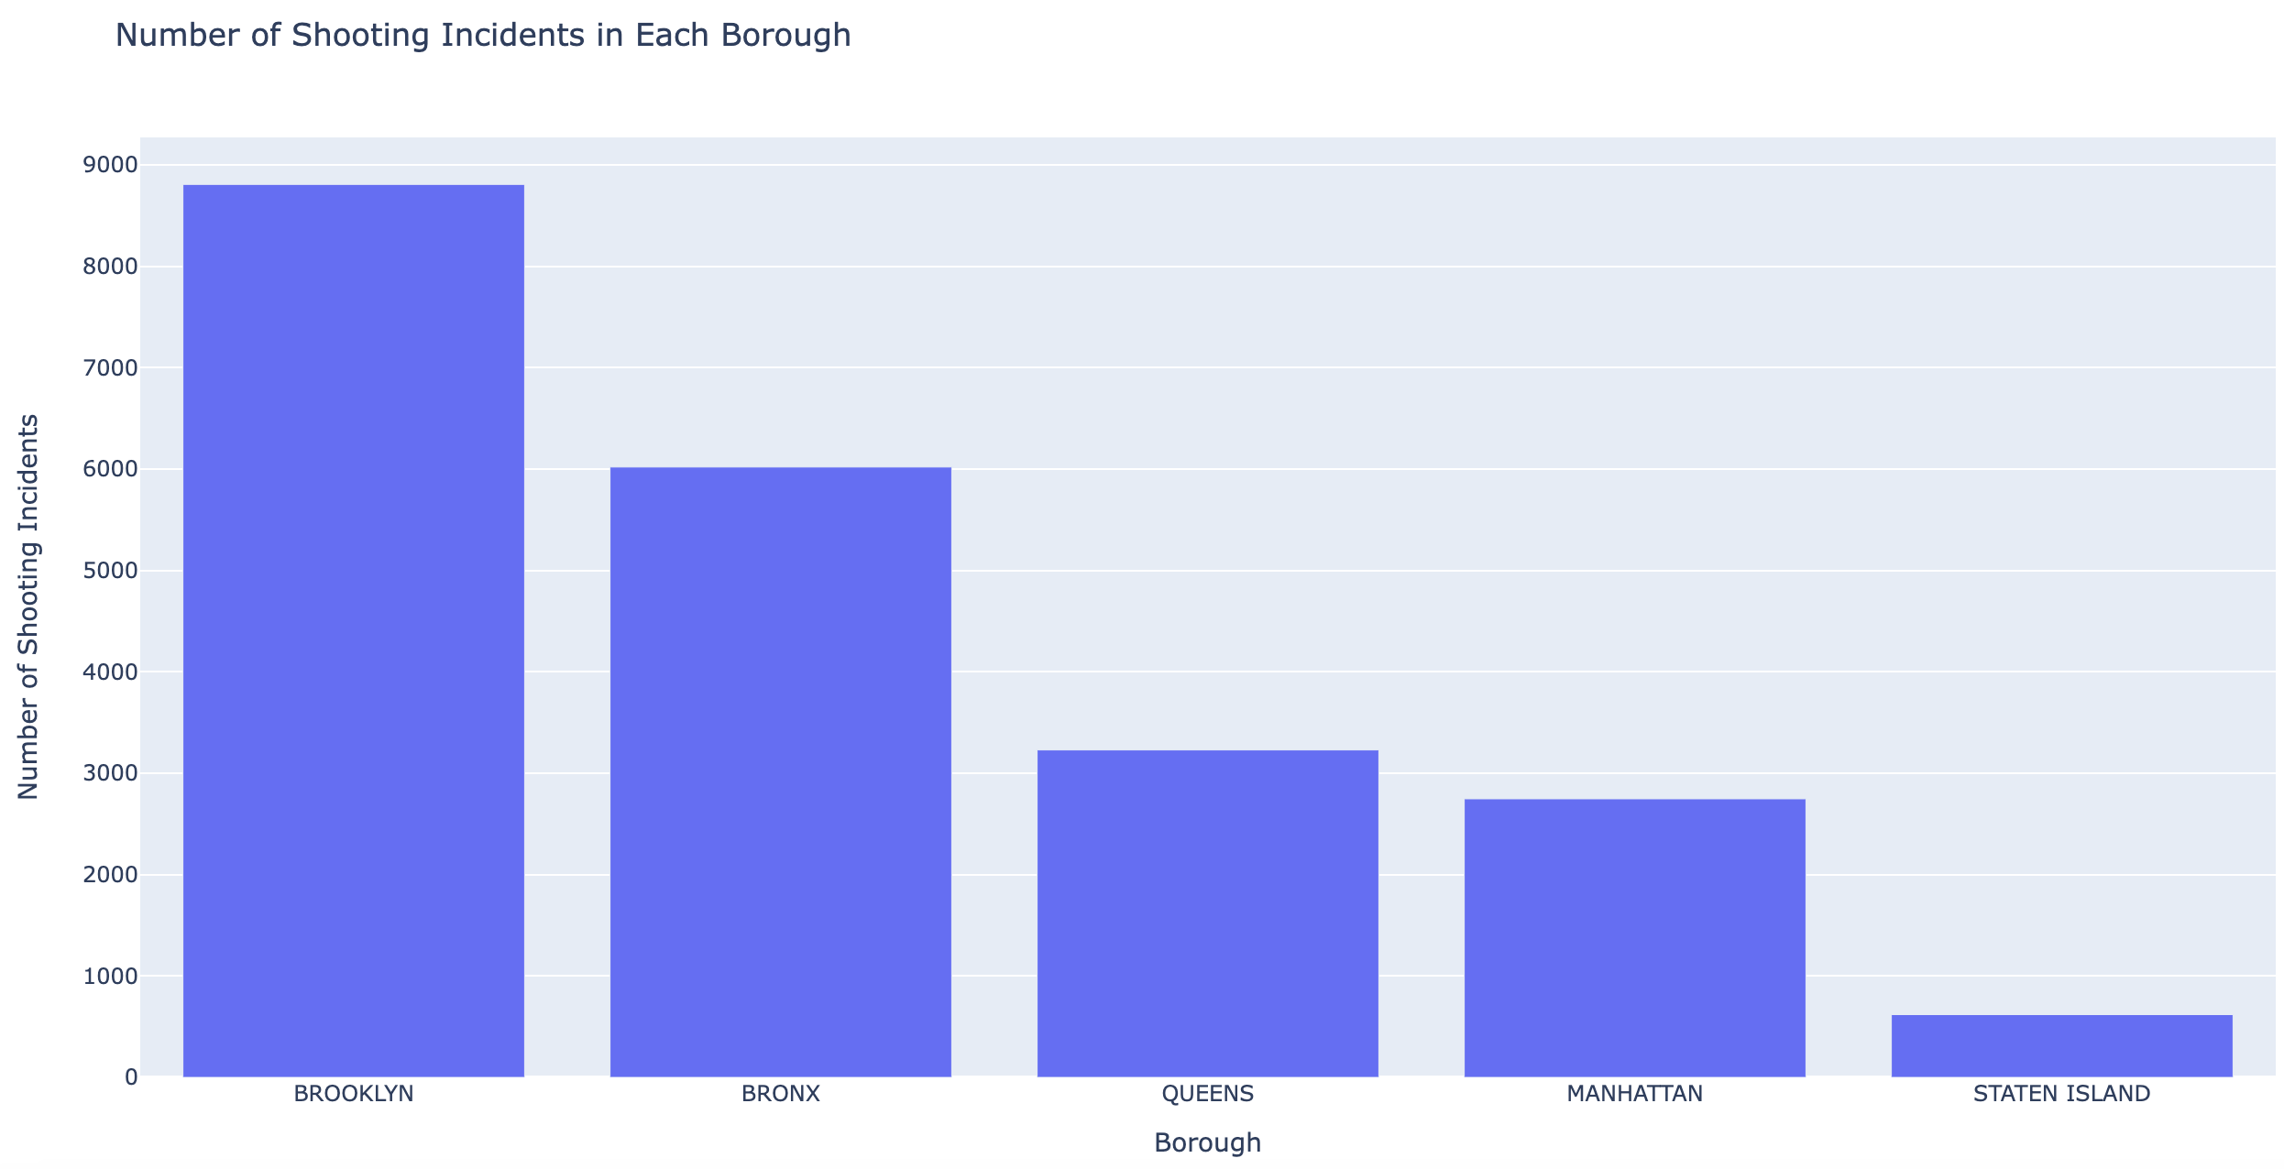
Shootings by borough
Notes:
file:///Users/madelineriley/Downloads/bar_chart.html

Slide 5
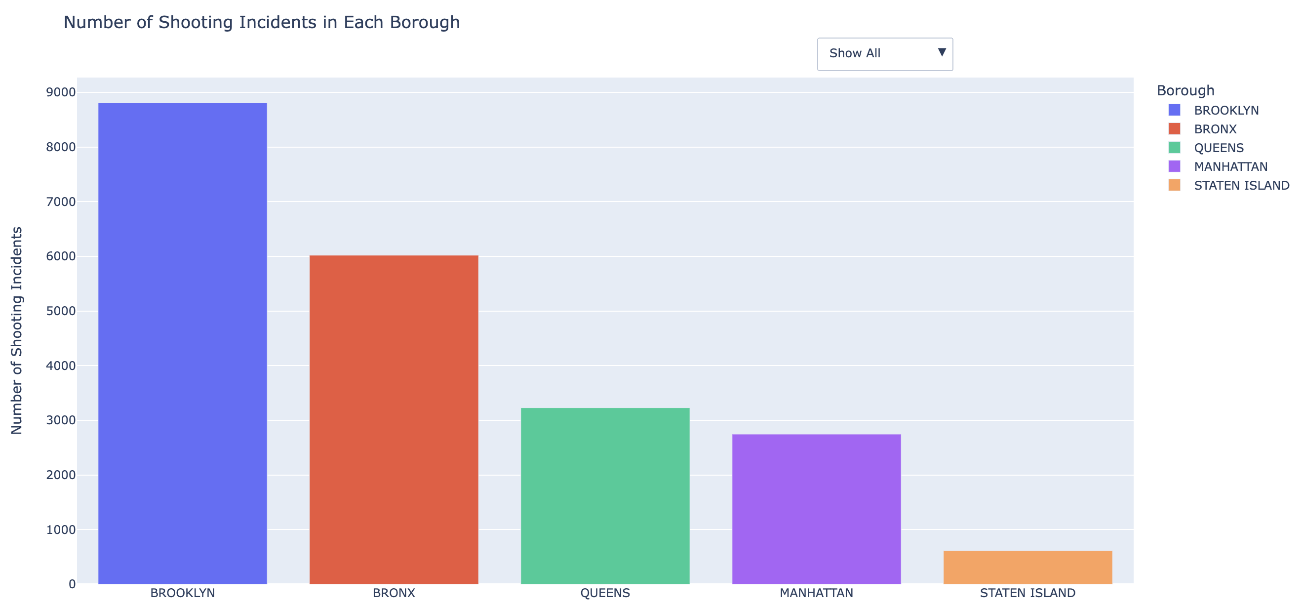
Shootings by borough

Slide 6
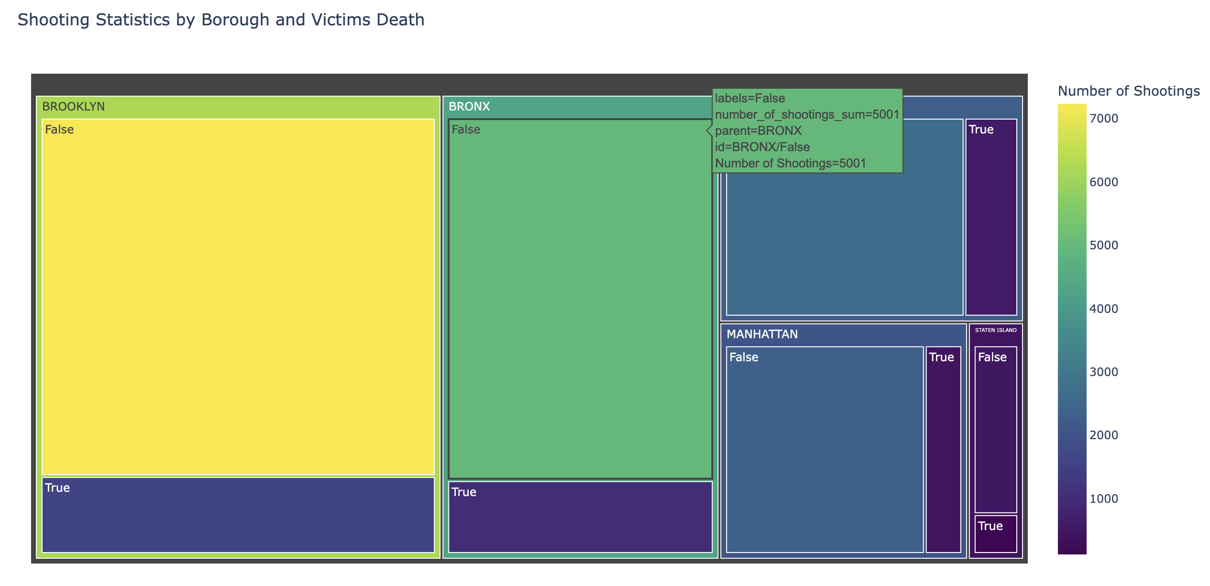
Shootings by borough

Slide 7
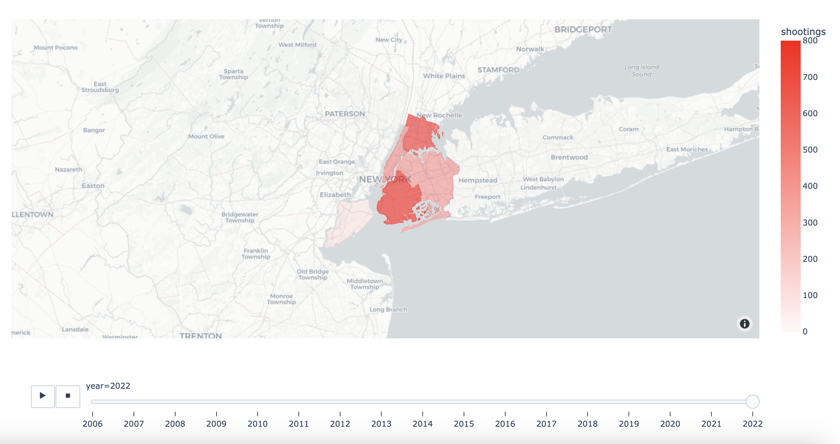
Shootings by borough

Slide 8
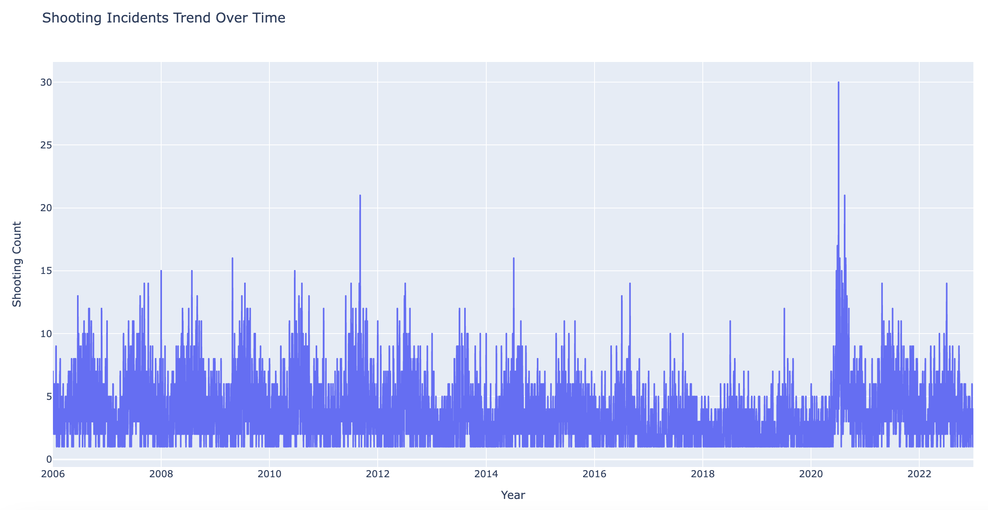
Shooting incidents over time

Slide 9
Location and time

Slide 10
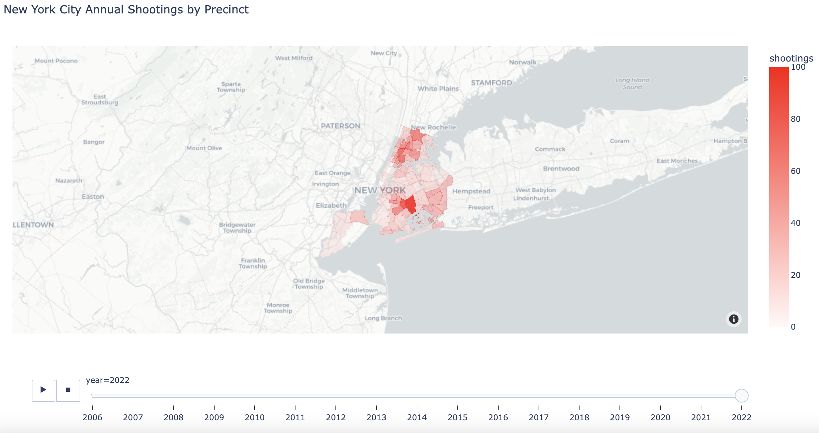
Shooting by precinct

Slide 11
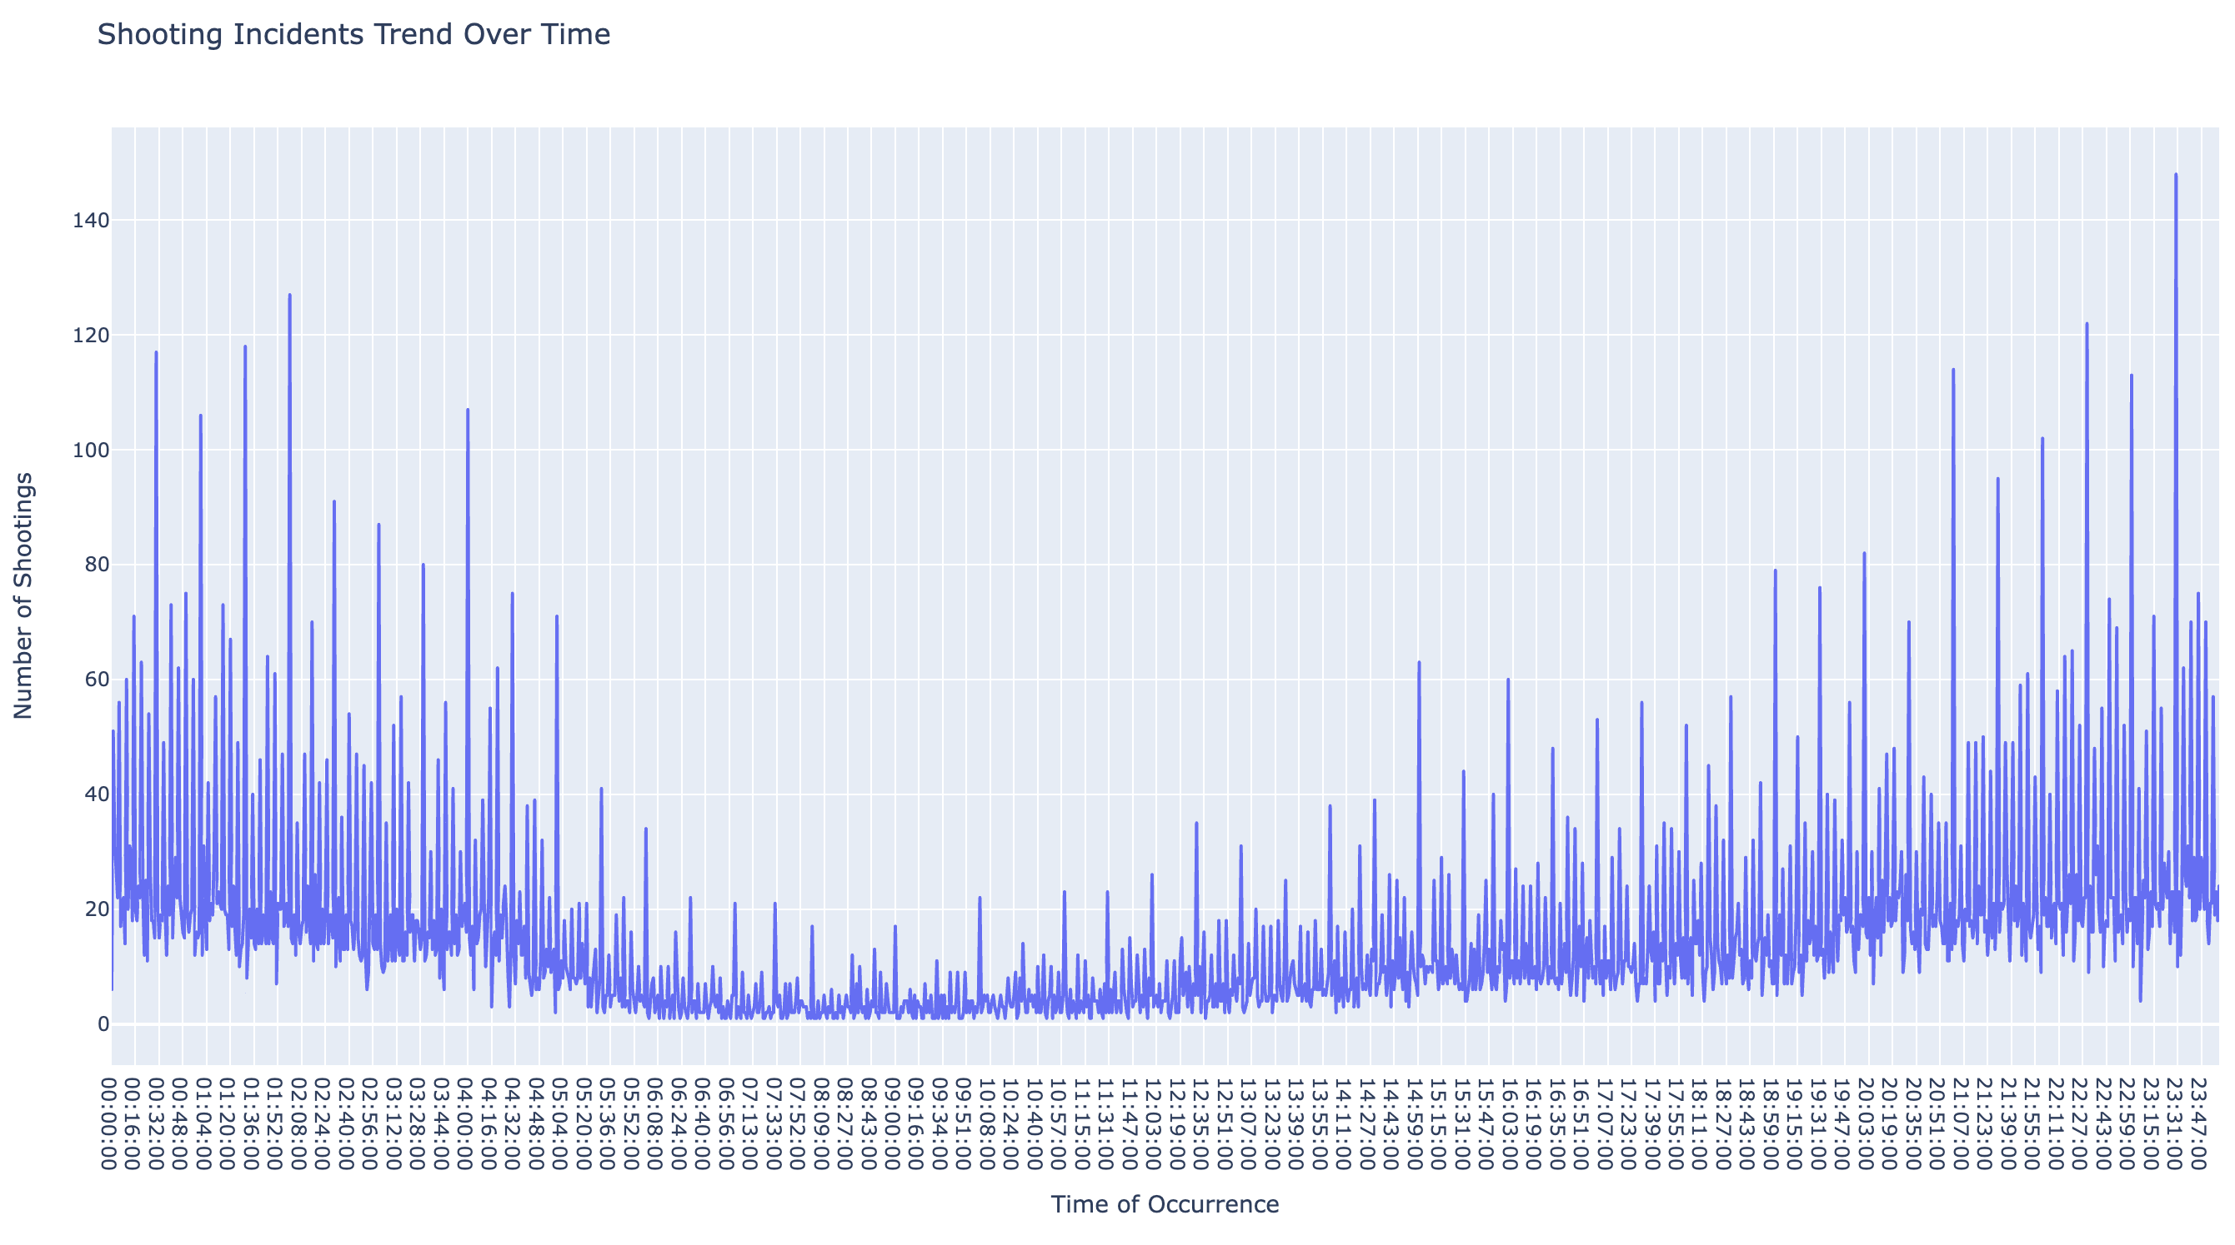
Shooting incidents over time

Slide 12
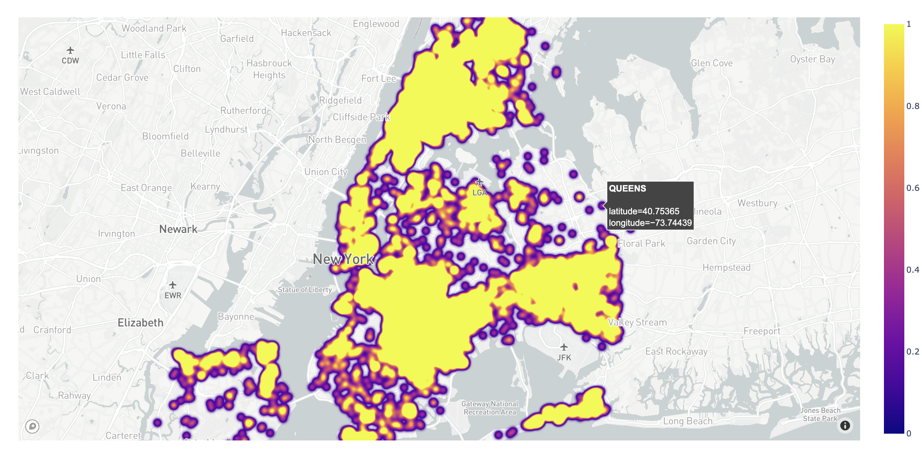
Heatmap of location

Slide 13
demographics

Slide 14
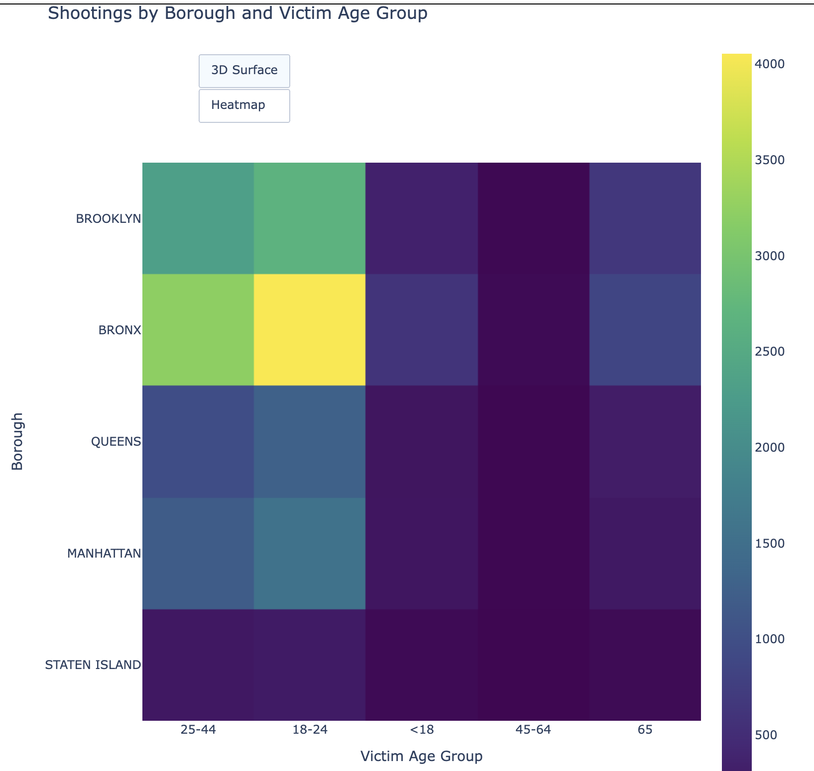
Shootings by borough and age

Slide 15
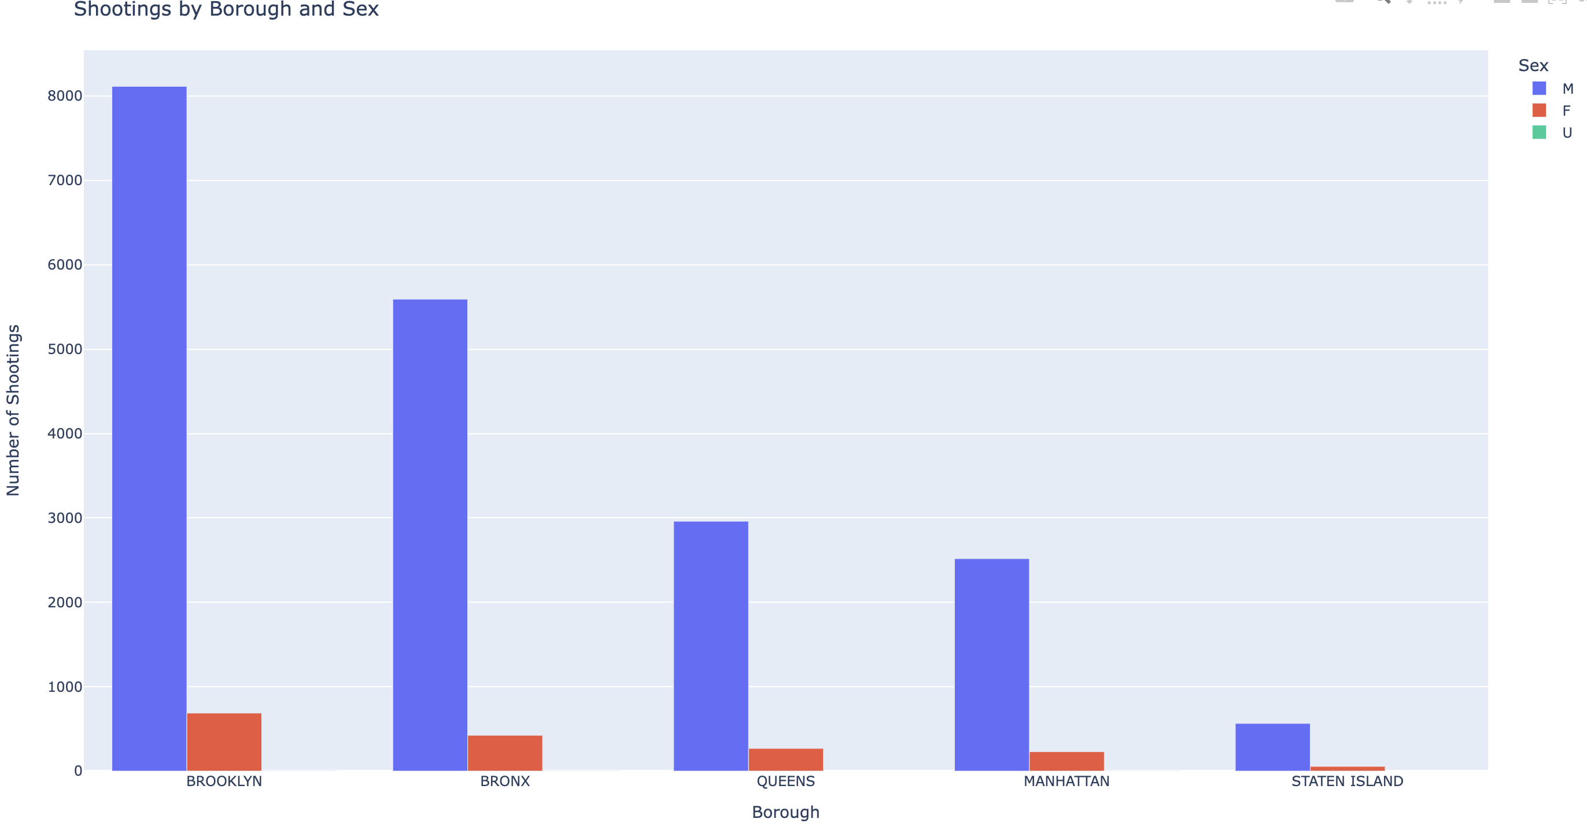
Shootings by borough and sex

Slide 16
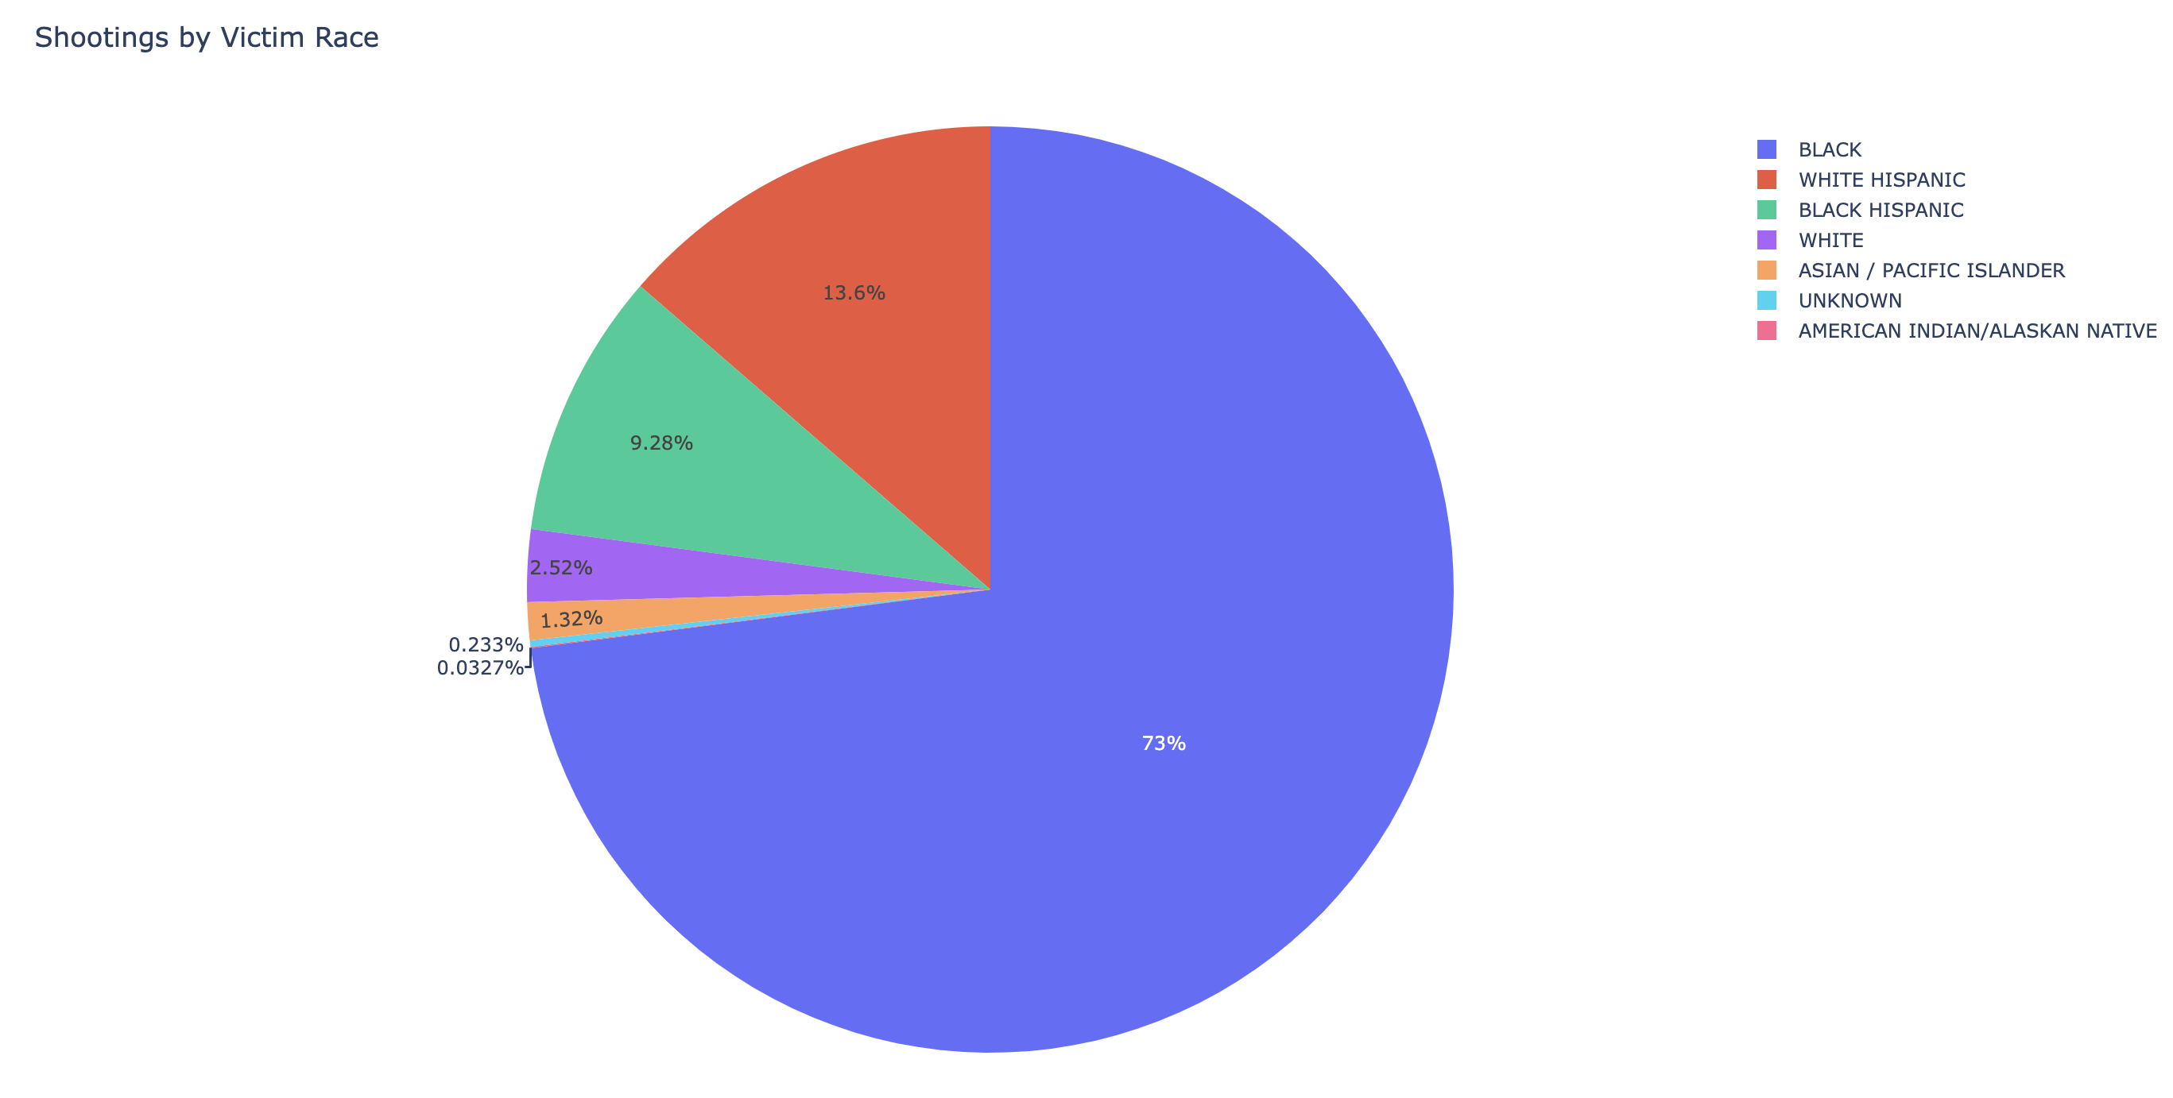
Shooting victim by race

Slide 17
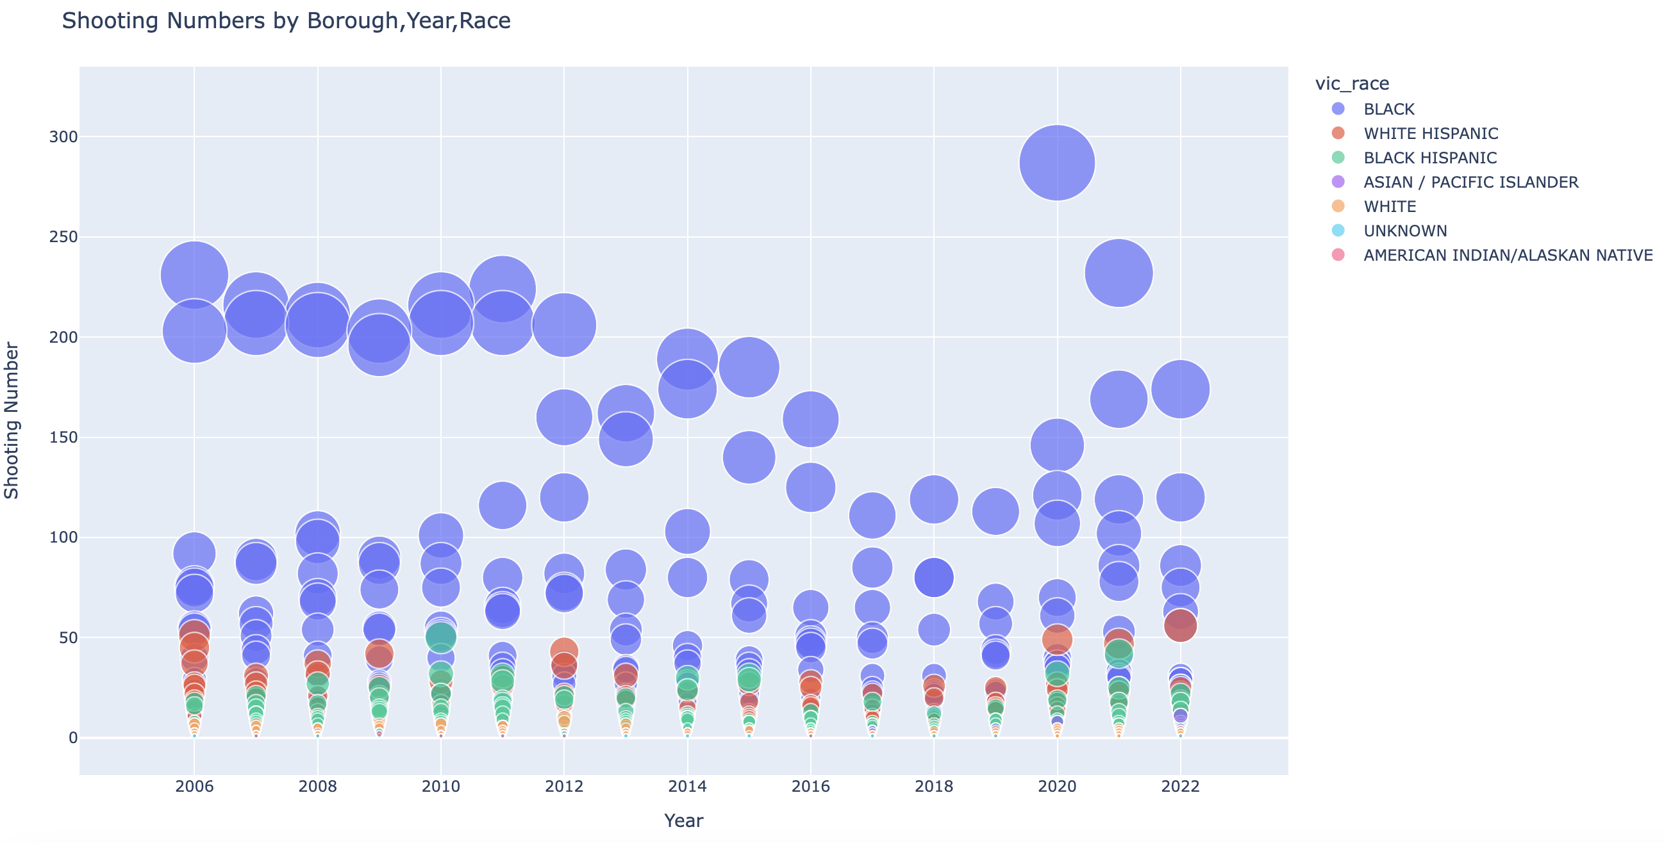
Shooting by borough by race

Slide 18
Resources
https://catalog.data.gov/dataset/nypd-shooting-incident-data-historic
https://stackoverflow.com/questions/66242946/how-to-get-hour-month-from-timestamp-in-postgresql
https://stackoverflow.com/questions/76464207/how-to-create-heatmap-from-pandas-dataframe-with-annotated-values-in-percentage
https://data.cityofnewyork.us/City-Government/Borough-Boundaries/tqmj-j8zm
https://data.cityofnewyork.us/Public-Safety/Police-Precincts/78dh-3ptz

